Slide 1
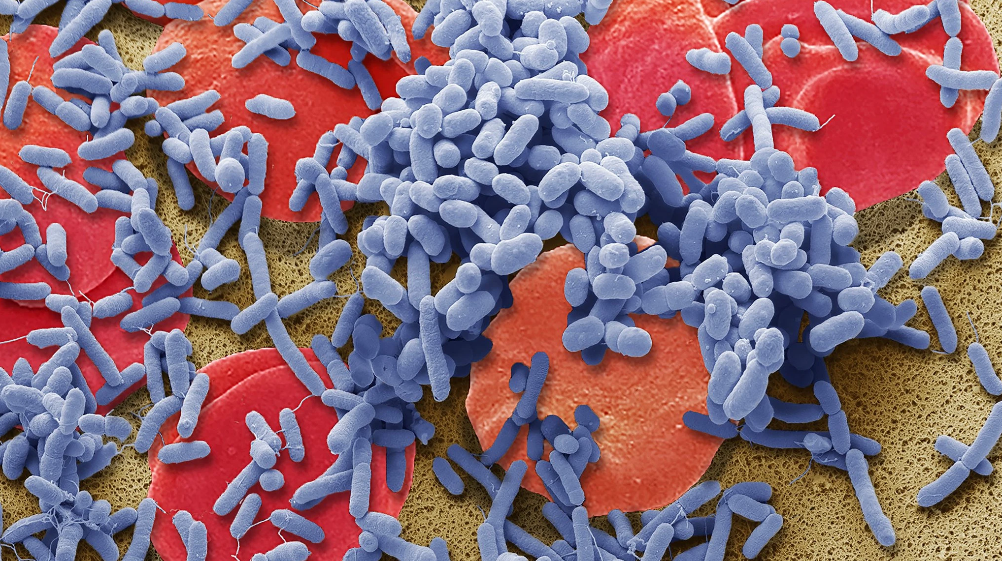
Early Prediction of Sepsis
in ICU Patients
Andy Zeng, Yidi Jiang, Steven Hirsch
CHL7001- Applied Deep Learning

Slide 2
Early Prediction of Sepsis
from Clinical Data
Andy Zeng, Yidi Jiang, Steven Hirsch
CHL7001- Applied Deep Learning

Slide 3
Introduction
Sepsis causes around 6 million death worldwide annually
Sepsis was reported to contribute to one in every eighteen deaths in Canada (2011), making it the twelfth leading cause of death (Statcan)
Sepsis cost US hospitals an estimated $24 billion USD annually. Much of the costs are associated with patients that were not detected with sepsis early in their admission.

Slide 4
Introduction
Current diagnostic tools are limited in their ability to make early detections/predictions on sepsis occurrence
With ever-increasing capacity to collect and monitor physiological markers in patients, deep learning approaches could utilize large scale clinical data and develop better models to detect sepsis early and accurately.

Slide 5
Data
The data is from an ongoing Computing in Cardiology Challenge
40 336 patients are recorded in the dataset. Each individual data consists of 41 clinical measurements (40 of which are time-dependent; 1 is the sepsis label, which has been shifted six hours ahead)
The number of observations per individual is dependent on the time in which the patient was in the ICU (one observation corresponds to one hour).
In total, the dataset has 1 522 210 observations

Slide 6
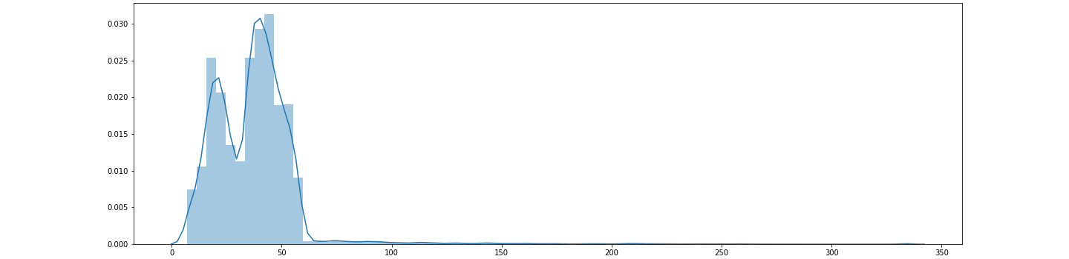
Length of ICU Stay
Average ICU Stay: 37.5 hours

Slide 7
there’s a lot of missing data.

Slide 8
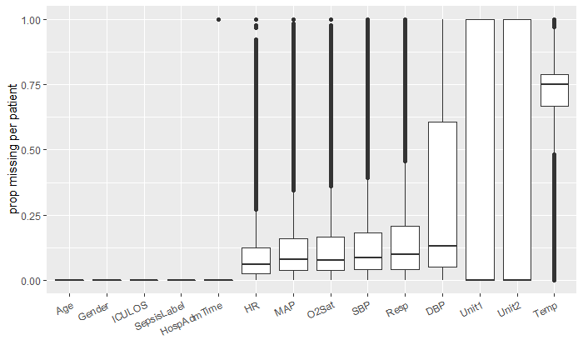
Missing Data (1 of 3)

Slide 9
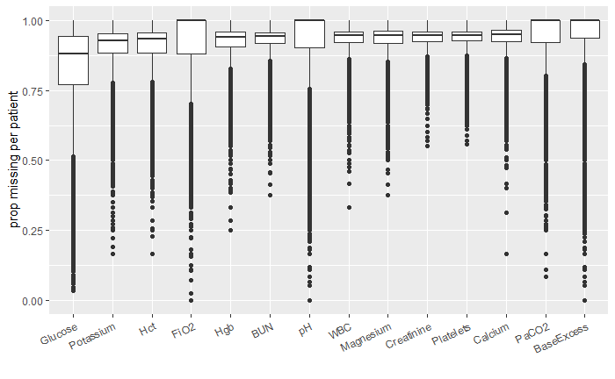
Missing Data (2 of 3)

Slide 10
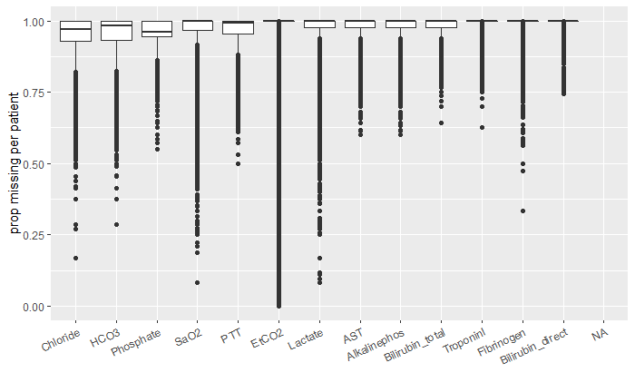
Missing Data (3 of 3)

Slide 11
Imputation - Common Approaches
Mean Imputation
Rationale: Simple and common approach in the field
Disadvantage: Uses information from future time points and other patients
Multiple Imputation by Chained Equations (MICE)
Rationale: iterative process where all available data are used to impute a given variable at a time; use random effect model to impute correlated longitudinal data
Disadvantage: Use future data to impute which is not reasonable

Slide 12
Imputation - Forward Fill
Rationale: - Normal physiological ranges vary across individuals - Imputation should not consider data from the future
Assumptions: - The observation has not changed since it was last measured
Disadvantages: - Some measurements fluctuate quickly: Heart rate from 48 hours ago may not be relevant now

Slide 13
Imputation - Sample and Hold
Forward filling based on the temporal resolution of each feature - Prevents forward filling indefinitely
Meant to simulate how different measurements are used in the clinic: - e.g. Blood tests do not need to be performed every hour
Remaining missing values are filled with a constant - We use 0 to 1 normalization for each feature - Missing values are assigned as -1

Slide 14
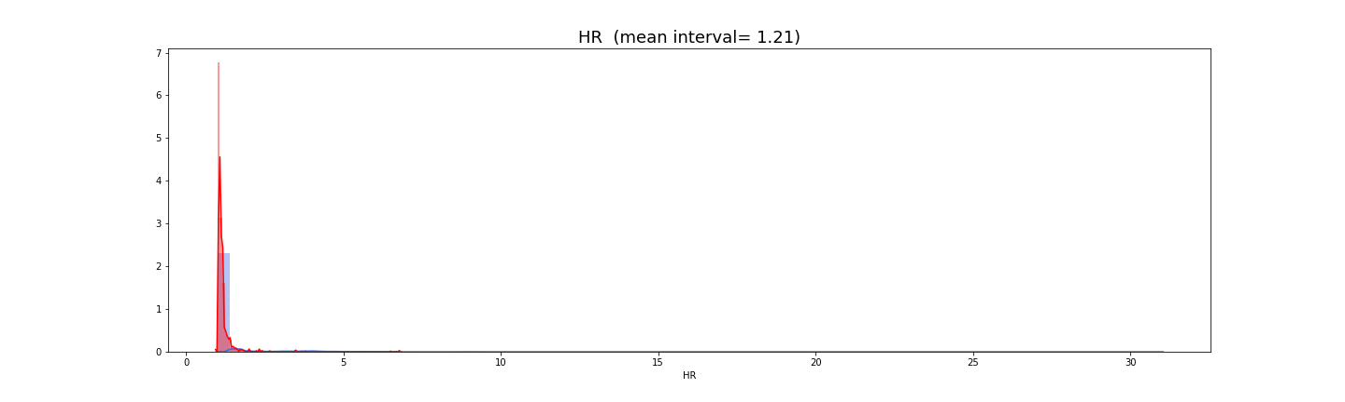
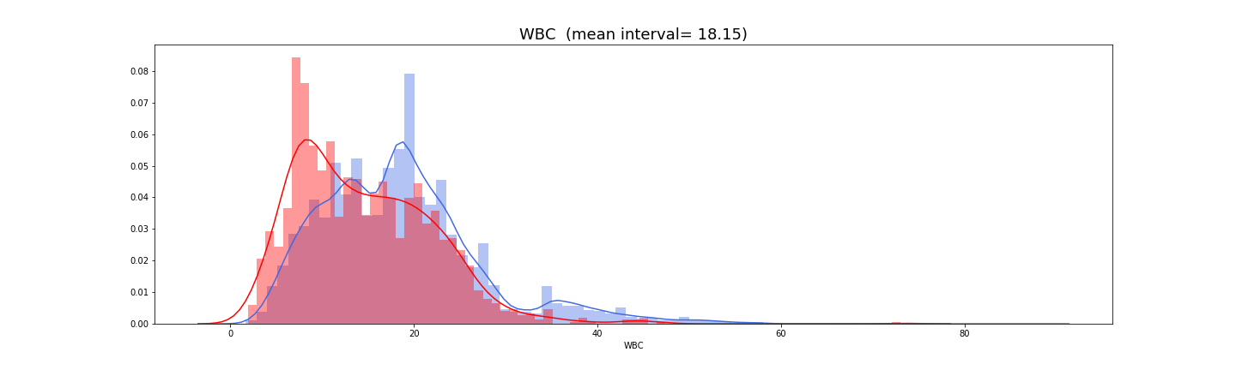
Imputation - Sample and Hold
Heart Rate (mean interval = 1.2 hr)
Number of Patients
Sepsis
No Sepsis
White Blood Cell Count (mean interval = 18.1 hr)
Time Interval between Measurements

Slide 15
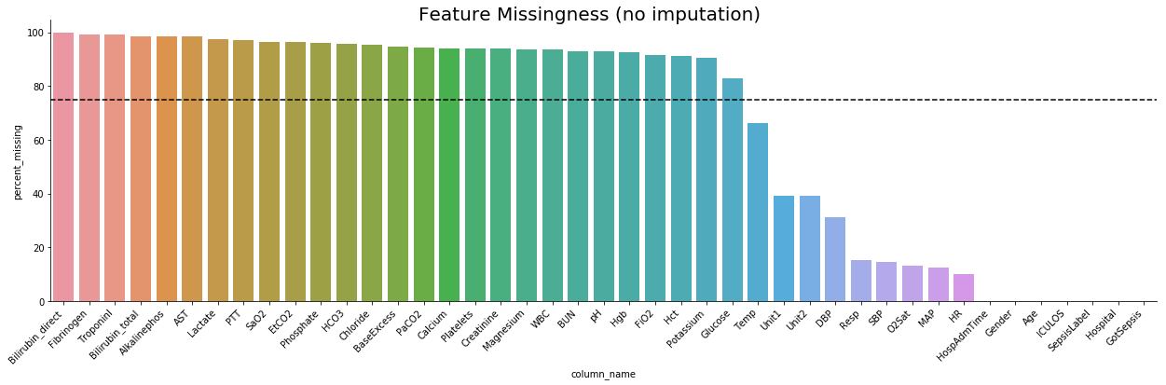
Feature Missingness before Imputation

Slide 16
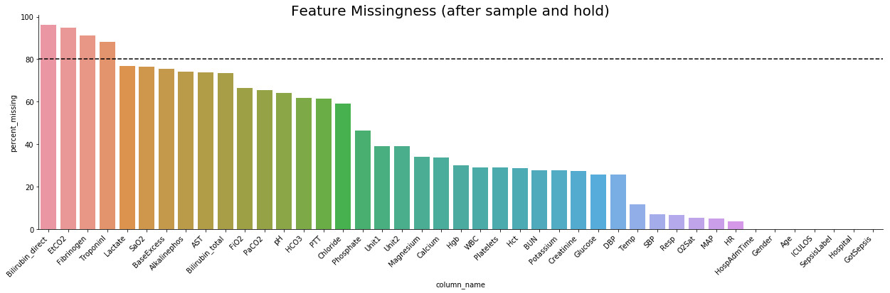
Feature Missingness before Imputation (S & H)

Slide 17
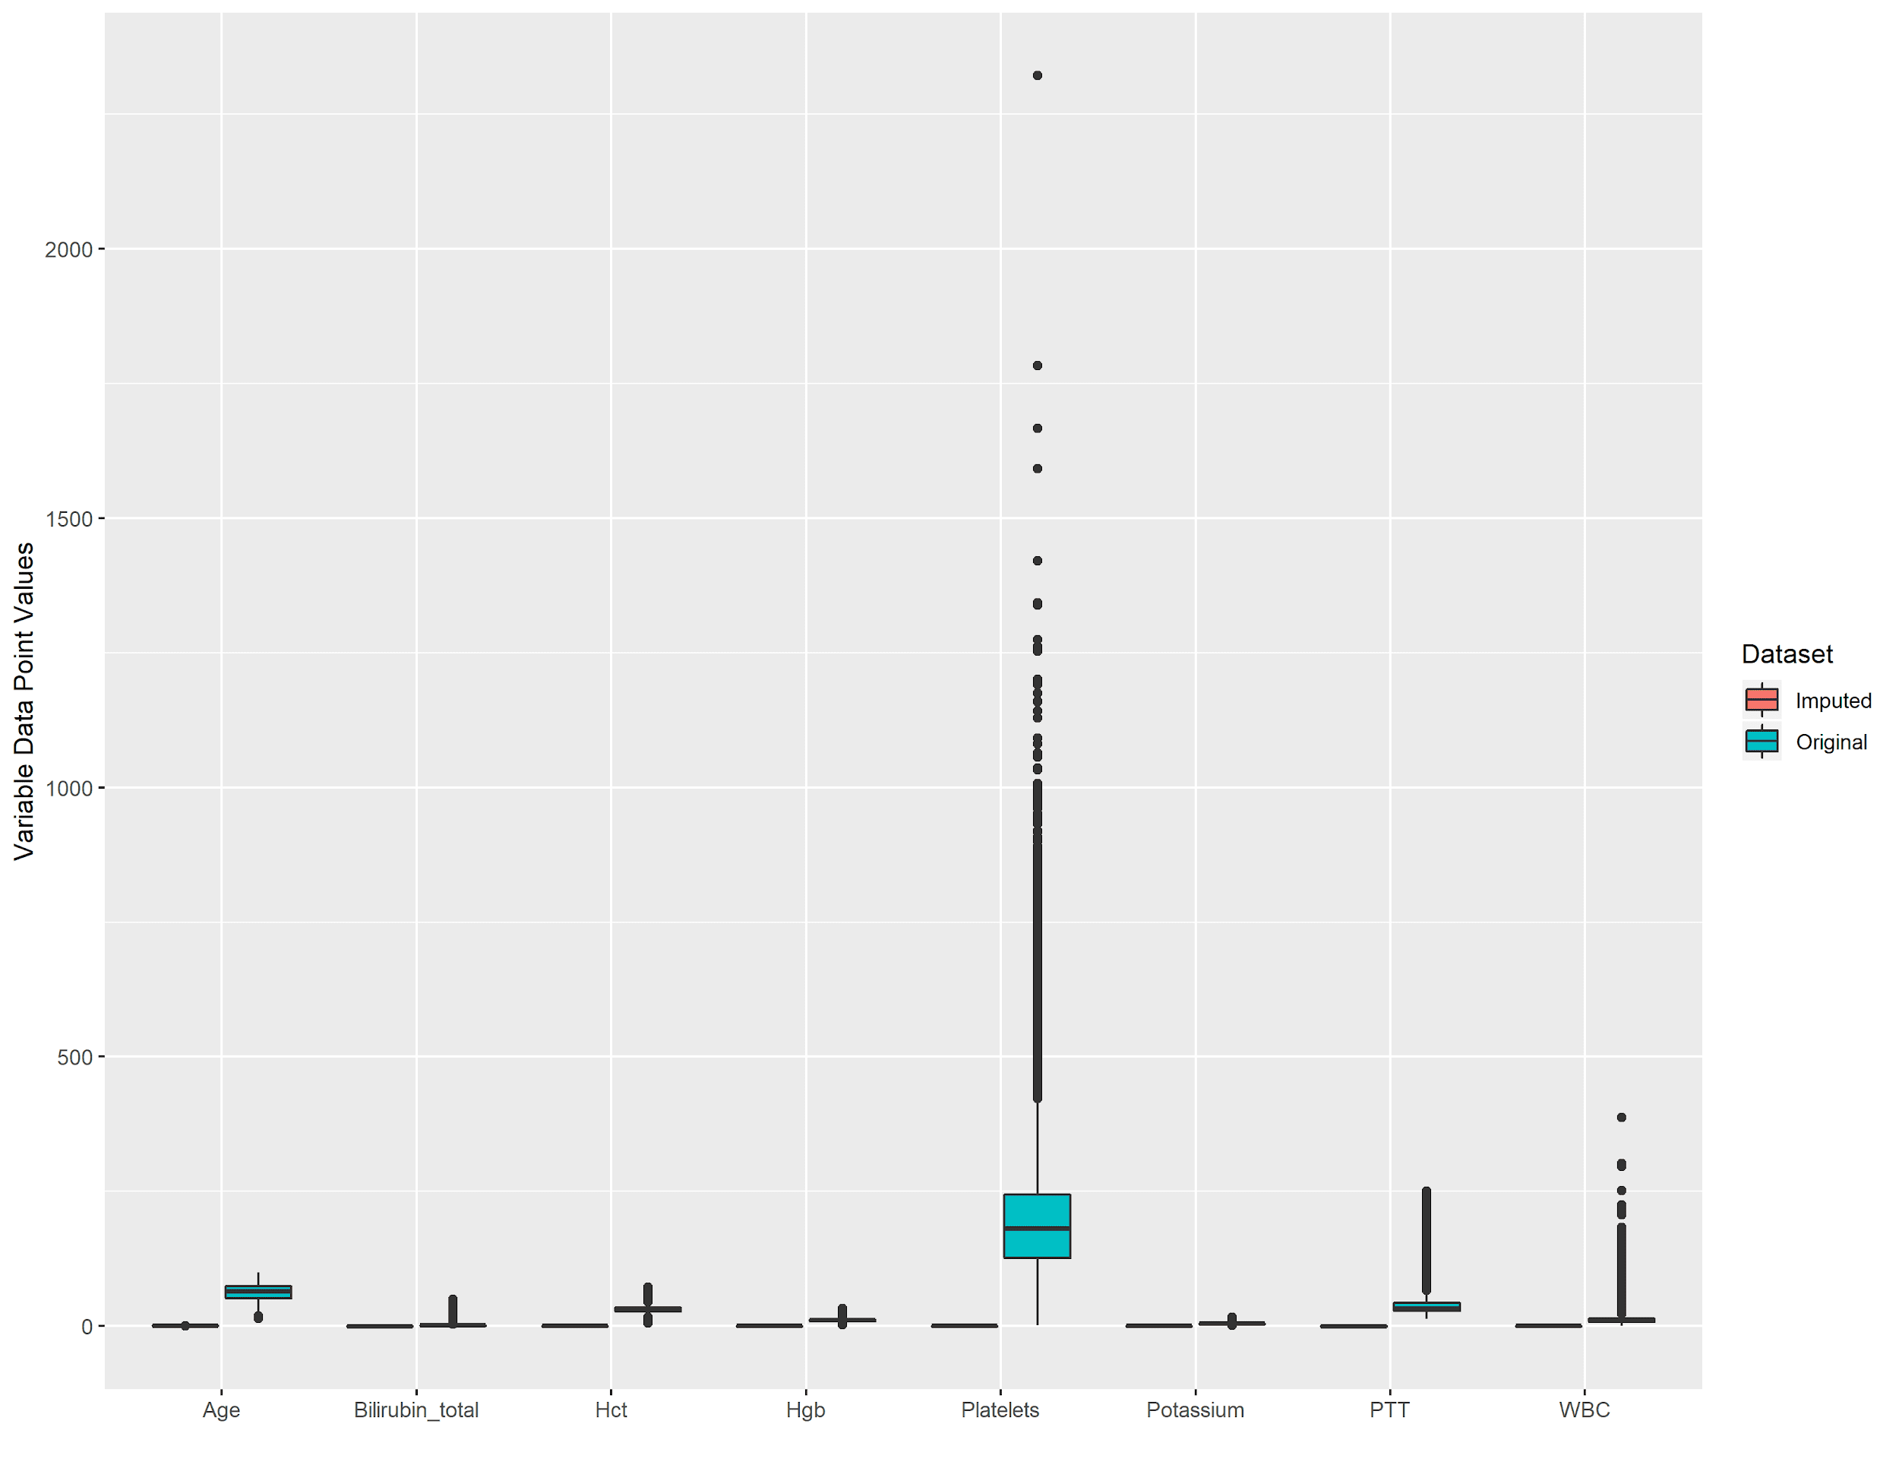
Data Distribution before and after
Imputation (1 of 5)

Slide 18
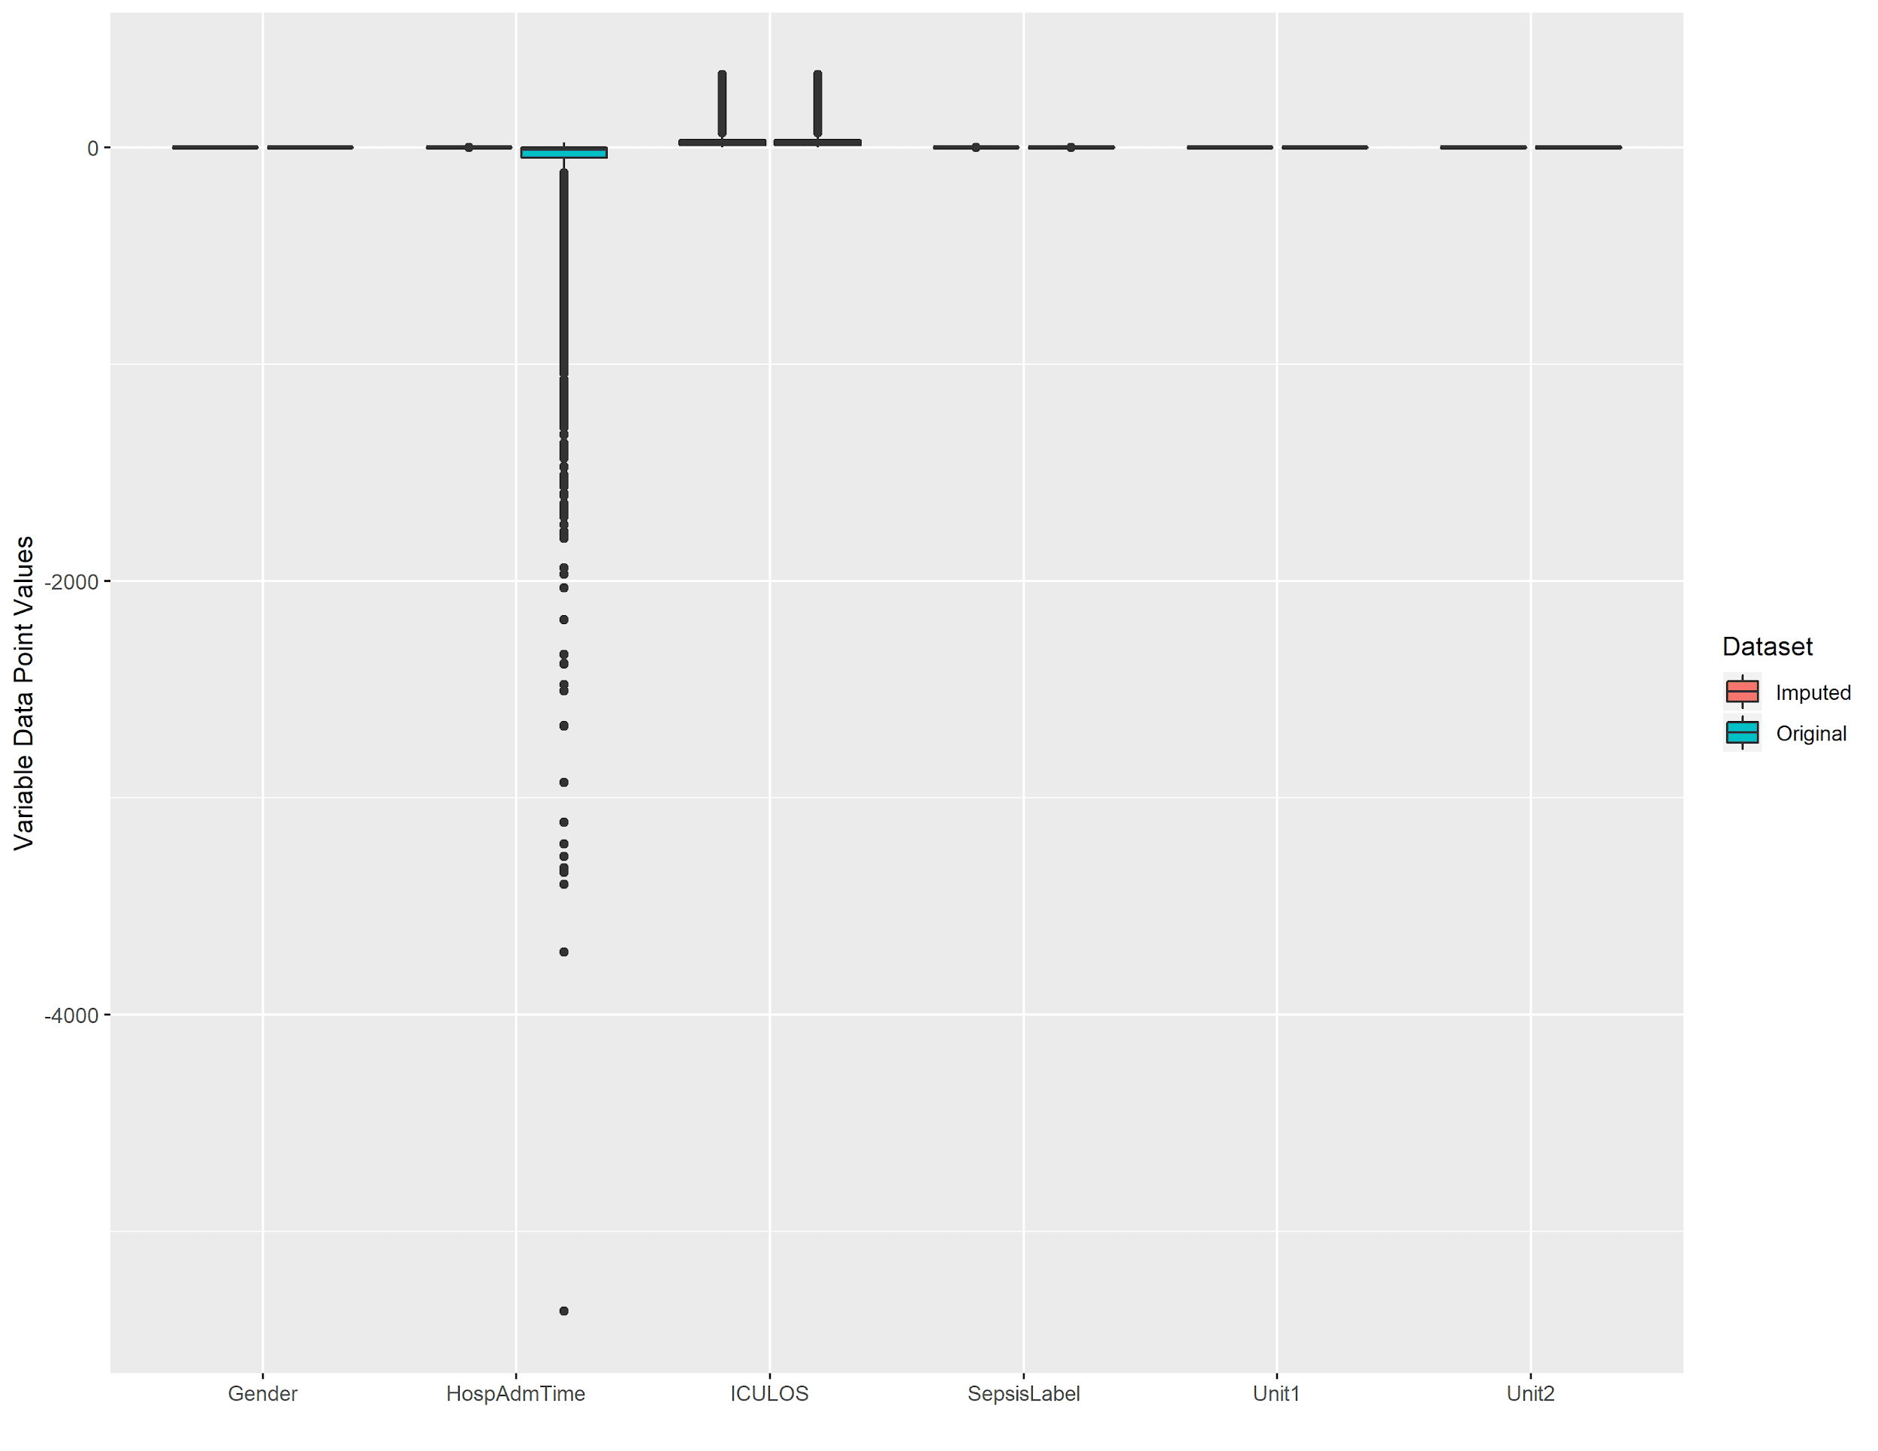
Data Distribution before and after
Imputation (2 of 5)

Slide 19
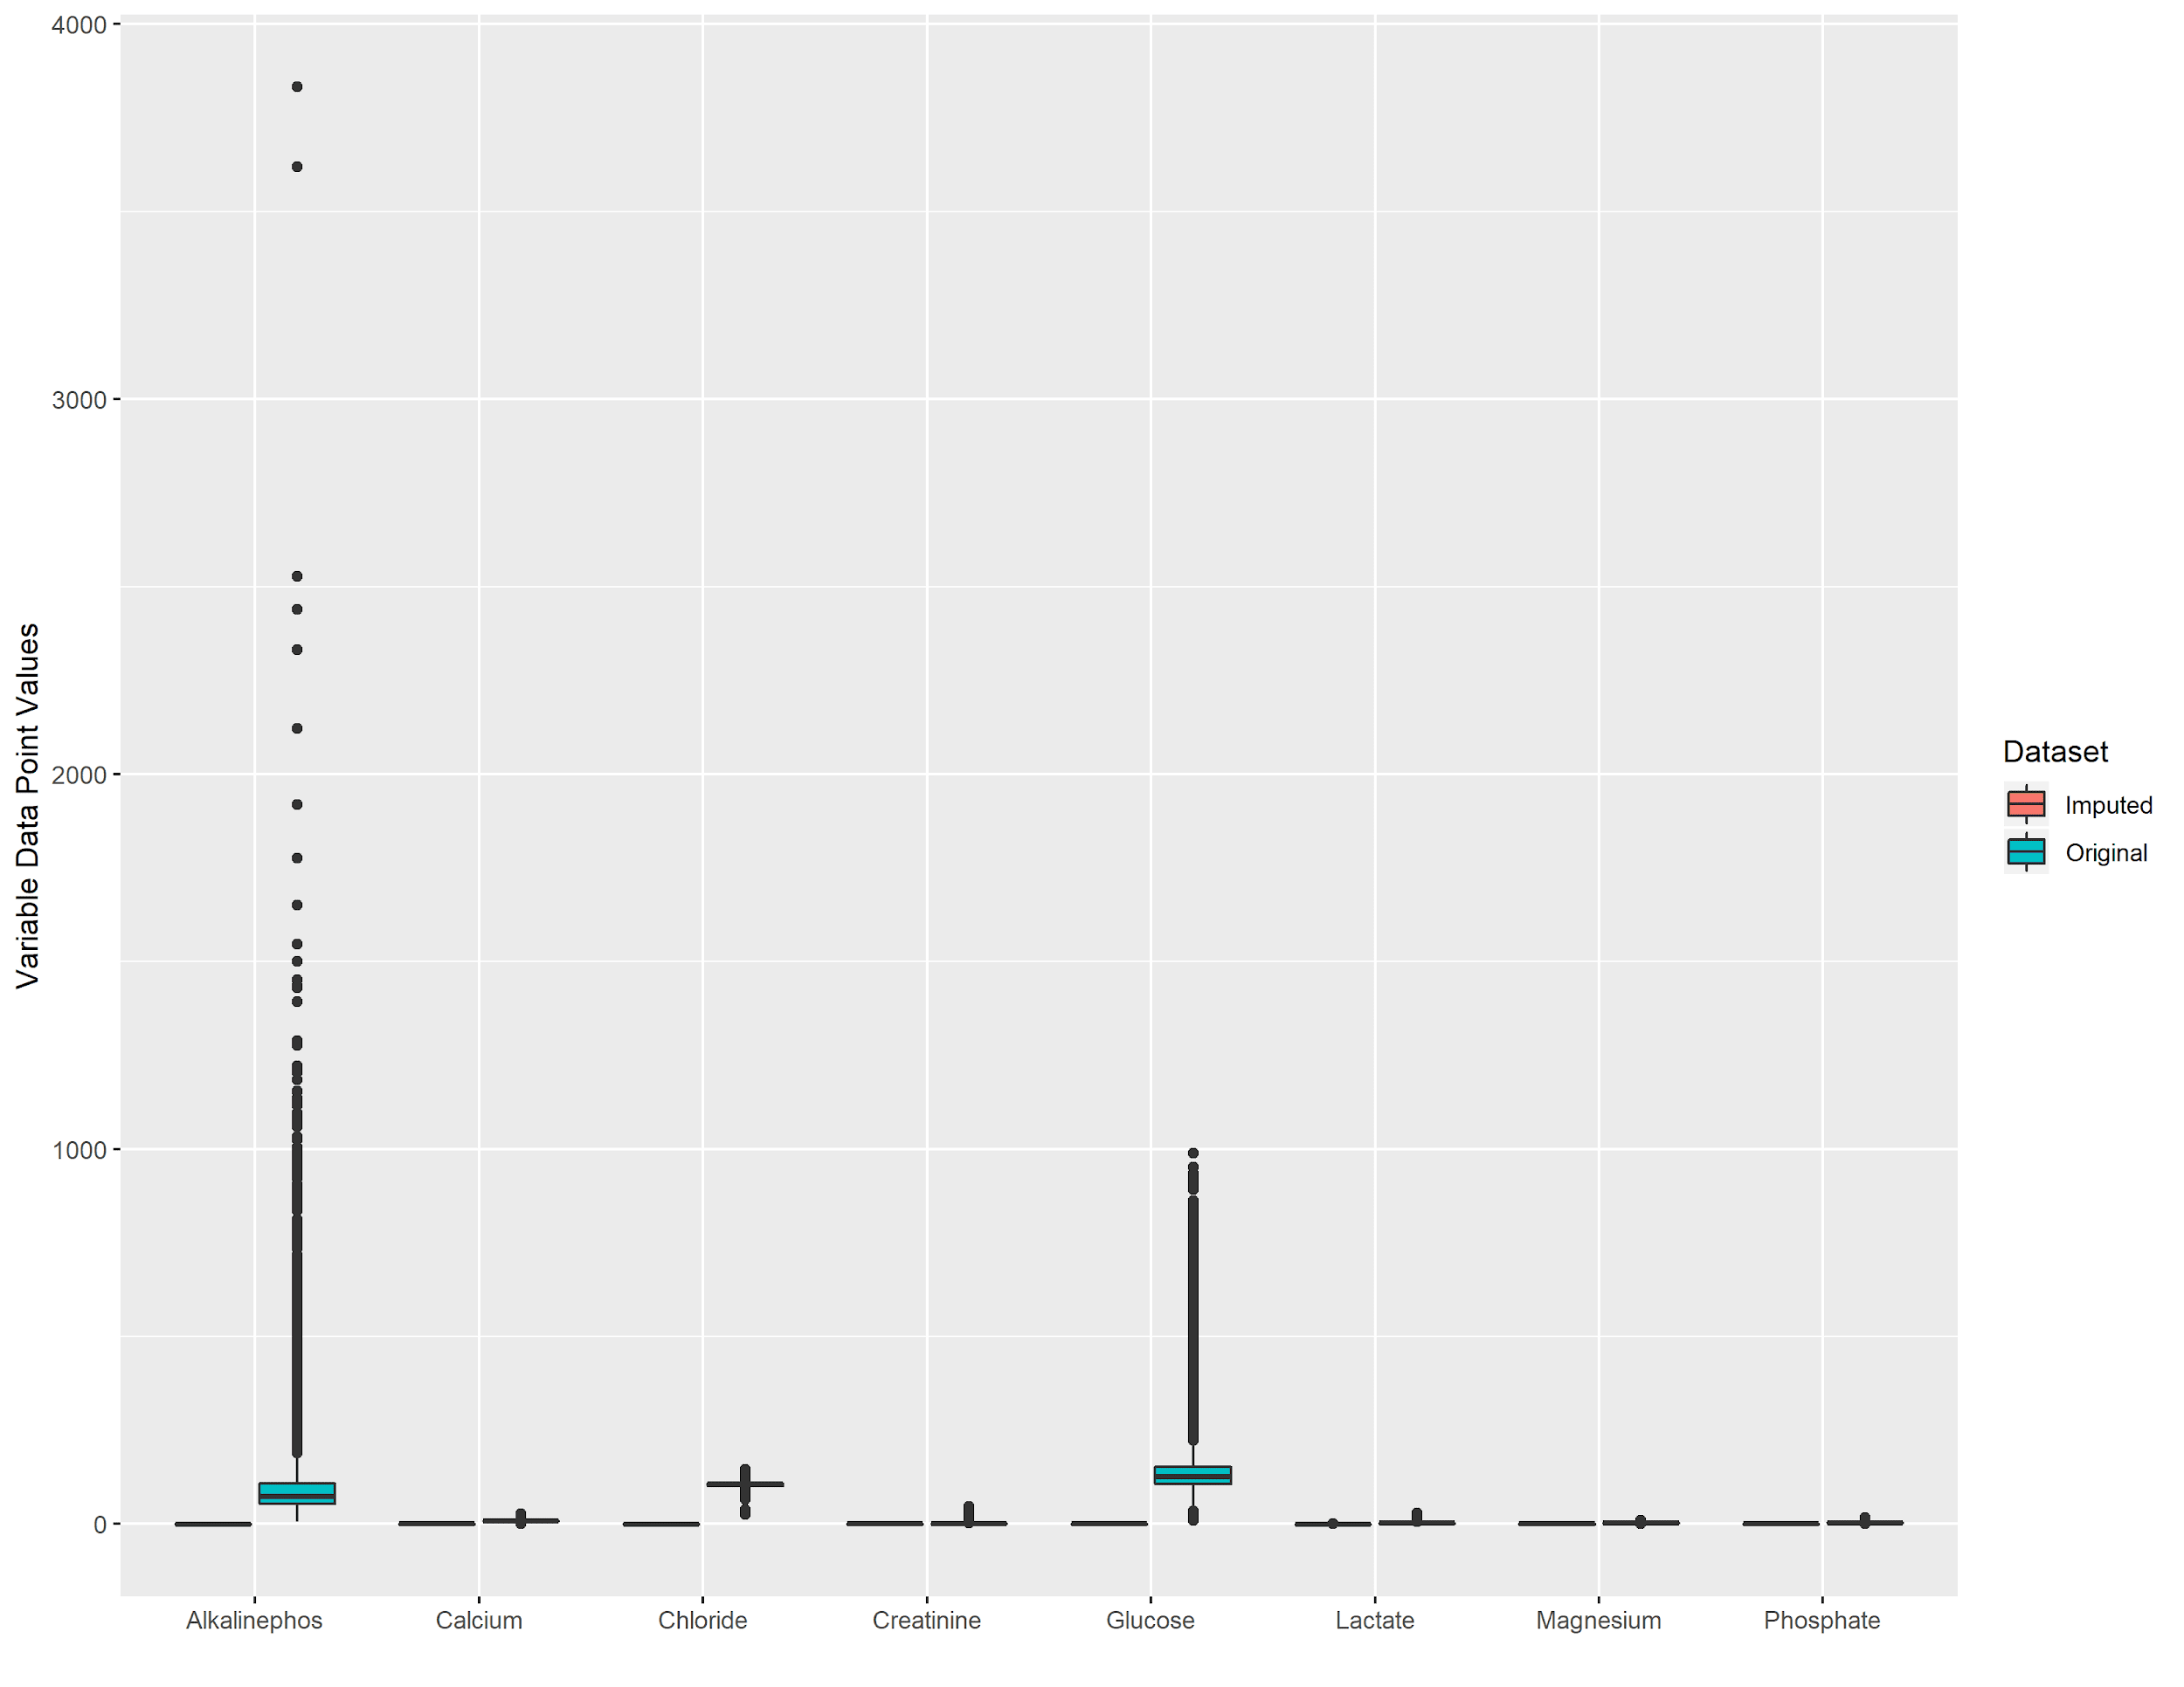
Data Distribution before and after
Imputation (3 of 5)

Slide 20
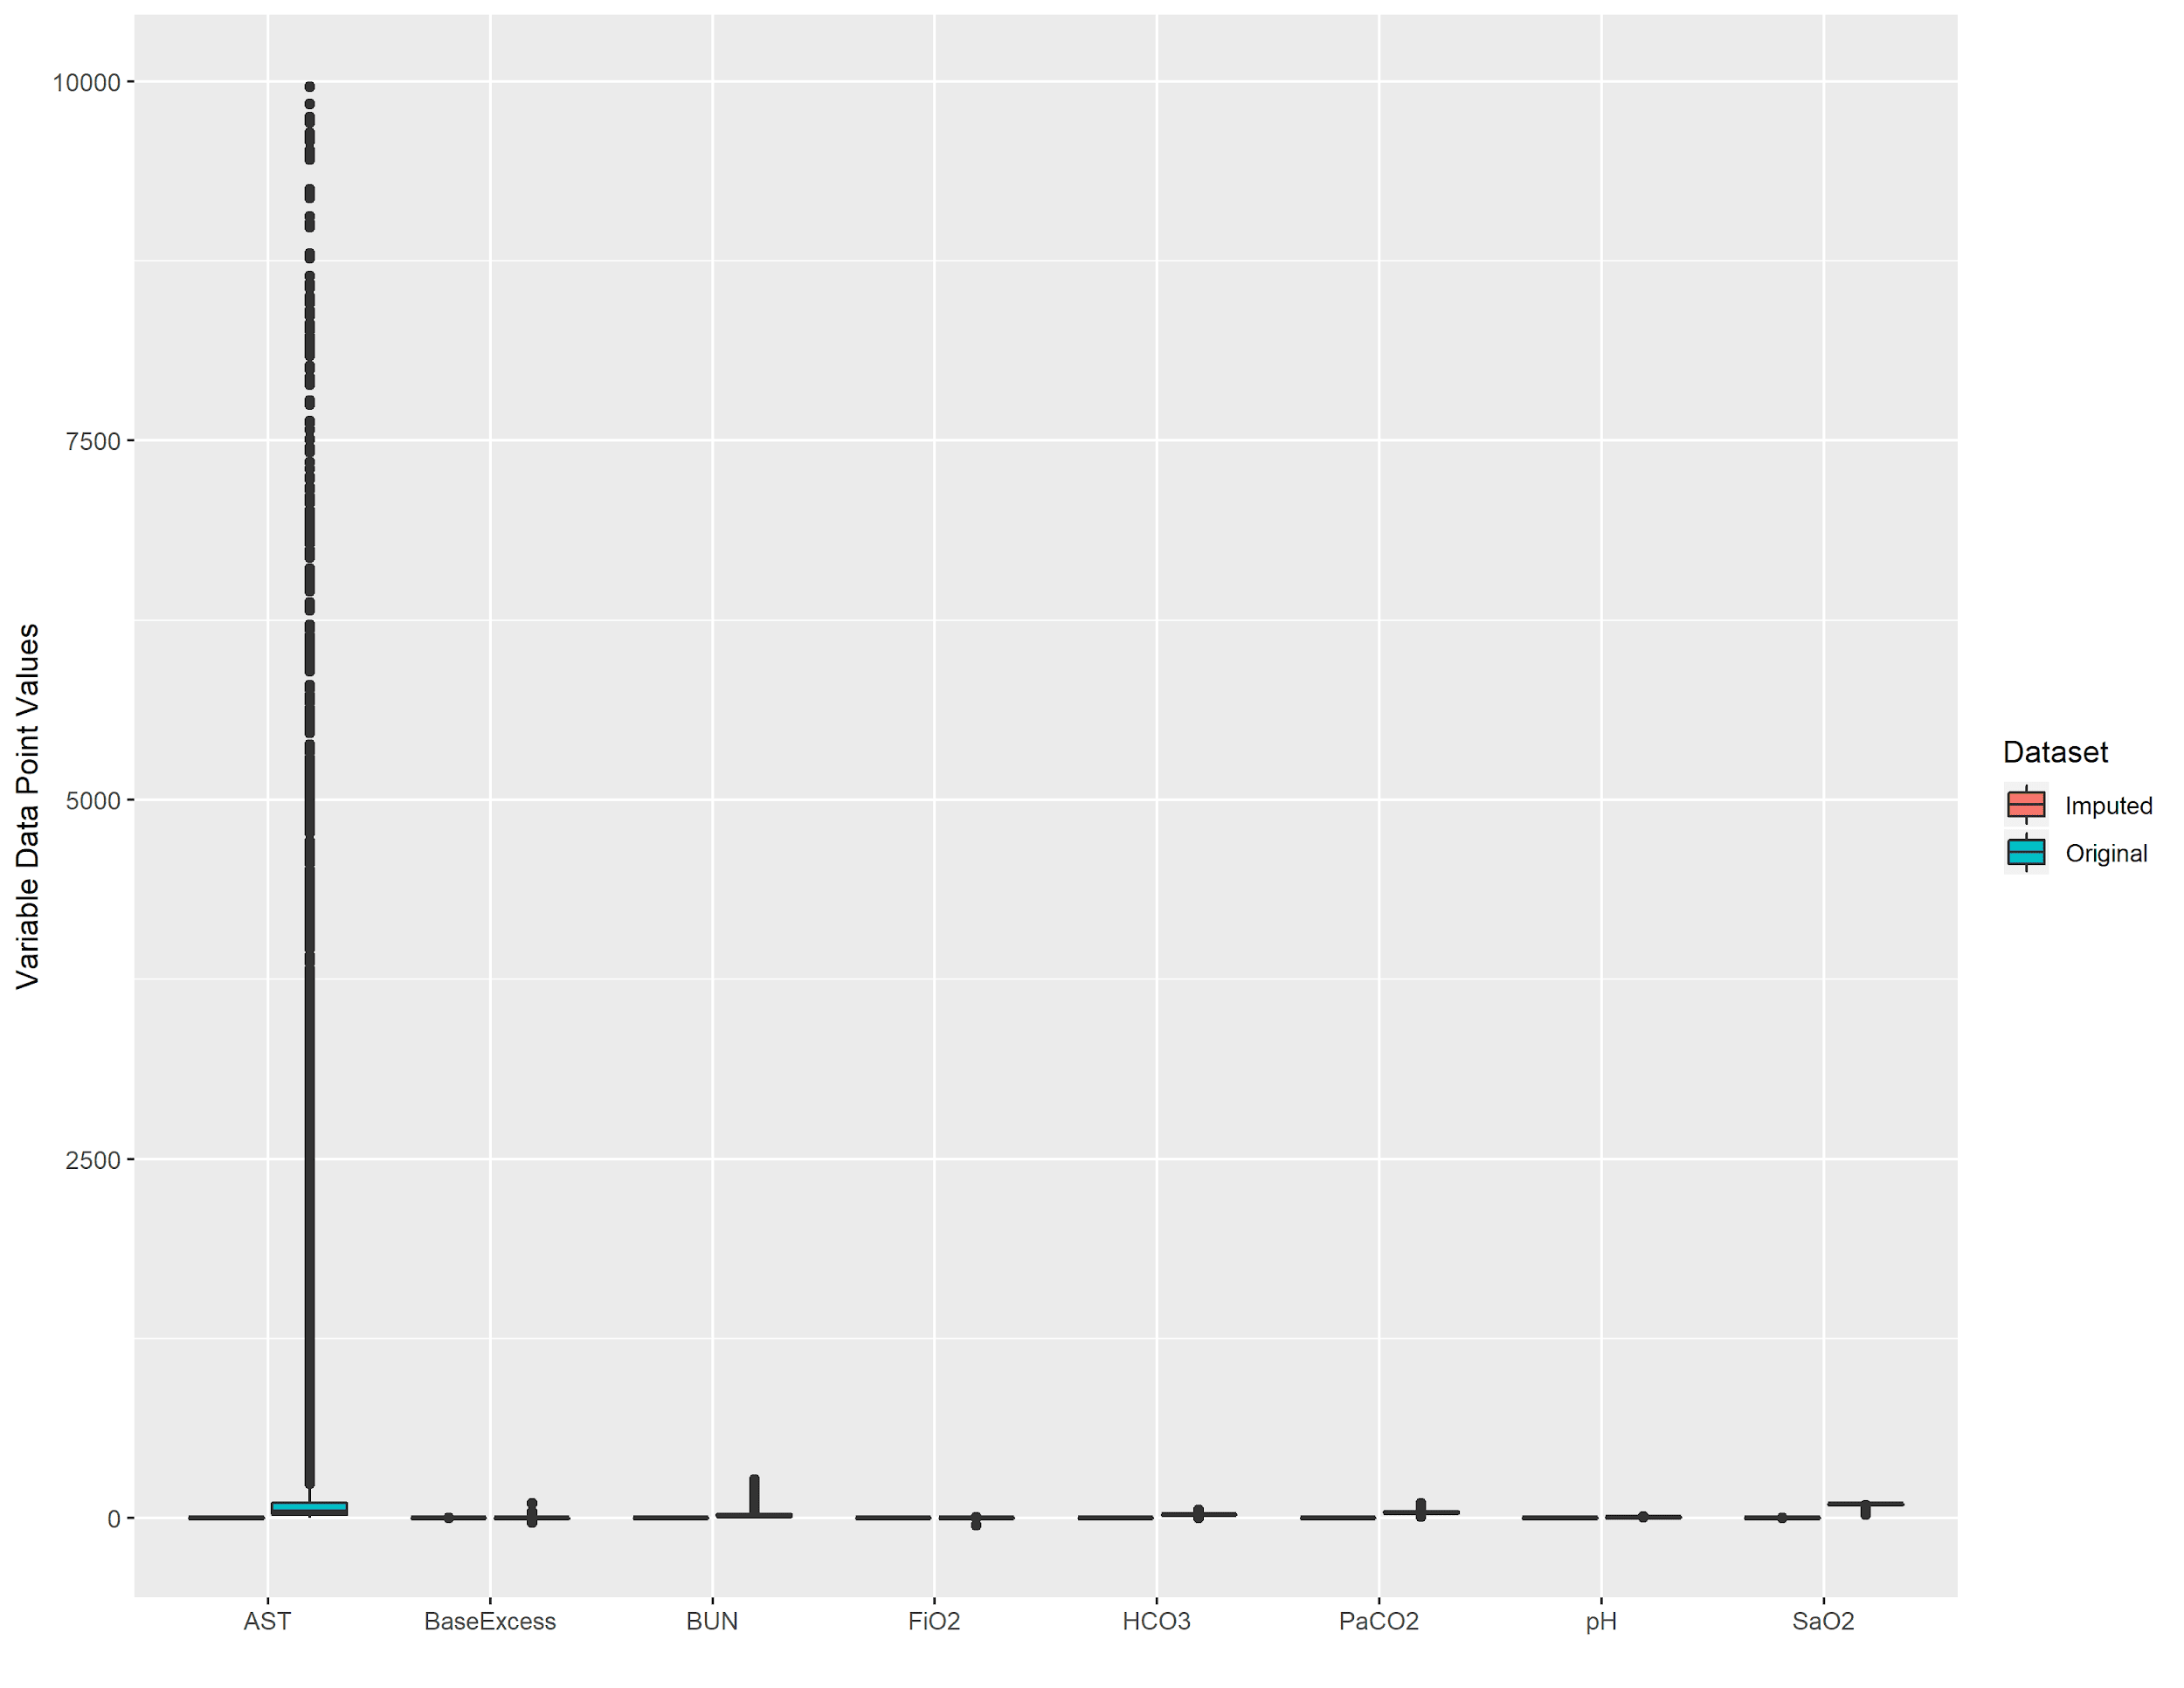
Data Distribution before and after
Imputation (4 of 5)

Slide 21
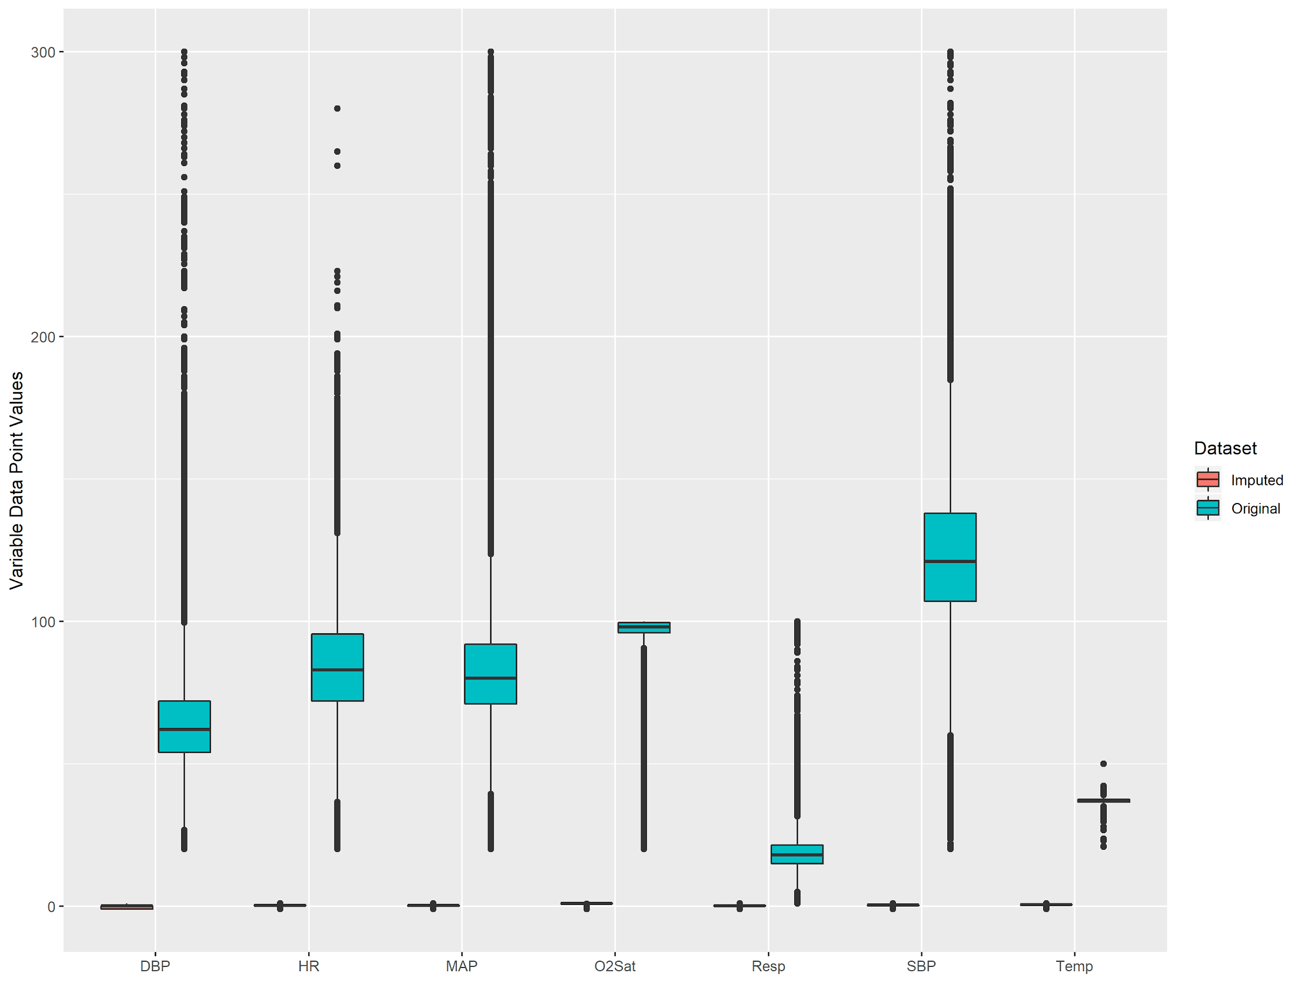
Data Distribution before and after
Imputation (5 of 5)

Slide 22
Neural Network Architecture

Slide 23
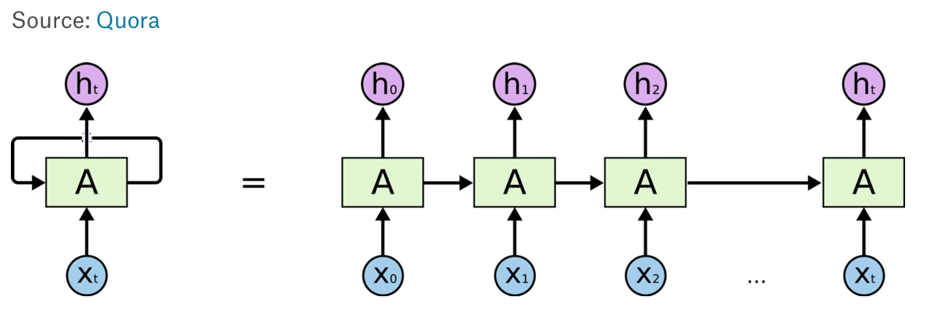
Recurrent Neural Networks (RNNs)

Slide 24
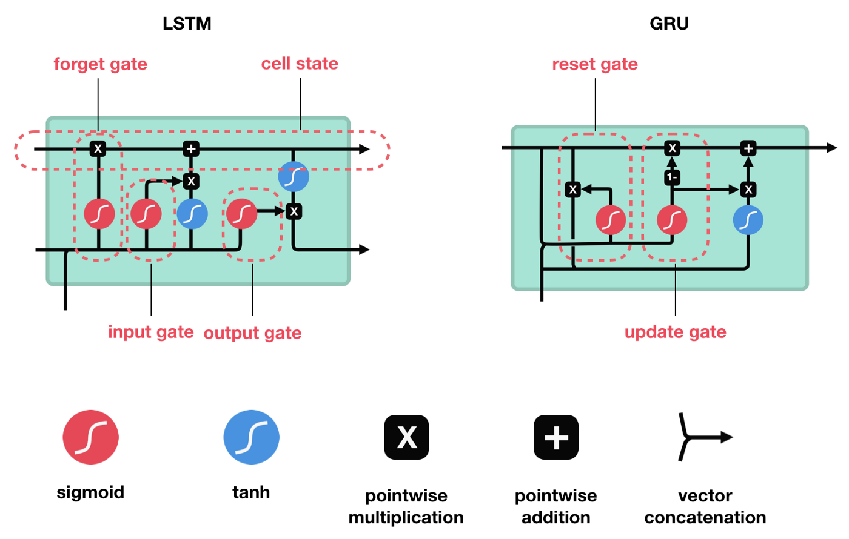
LSTM

Slide 25
LSTM
GRU

Slide 26
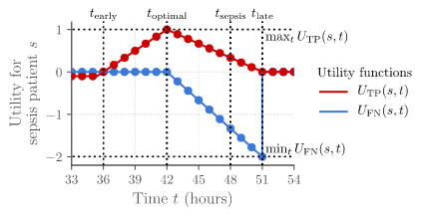
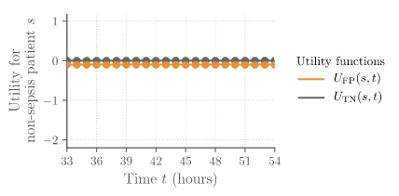
Model Evaluation
Sepsis Prediction Score - Rewards predicting Sepsis 12 hours before to 3 hours after - Penalizes late prediction of Sepsis True Positive False Negative False Positive True Negative

Slide 27
Model Hyperparameters
Data Preprocessing
Imputation Method
Missing Threshold
Number of Past Hours
Upsampling Ratio
Extra Padding
Model Architecture
RNN Type (LSTM vs GRU)
Number of RNN Layers
RNN Layer Size
RNN Dropout
Number of Dense Layers
Dense Layer Size
Dense Dropout
Gradient Descent
Sepsis Class Weight
Optimizer
Batch Size
Learning Rate
Decay
Momentum

Slide 28
Hyperparameter Optimization
18 Hyperparameters with 2-7 options each - 23 billion unique combinations
GridSearch is impossible - Training 1 model at a time on GCP: ~5 million years
Random Search is inefficient - Consider Bayesian or Evolutionary Optimization

Slide 29
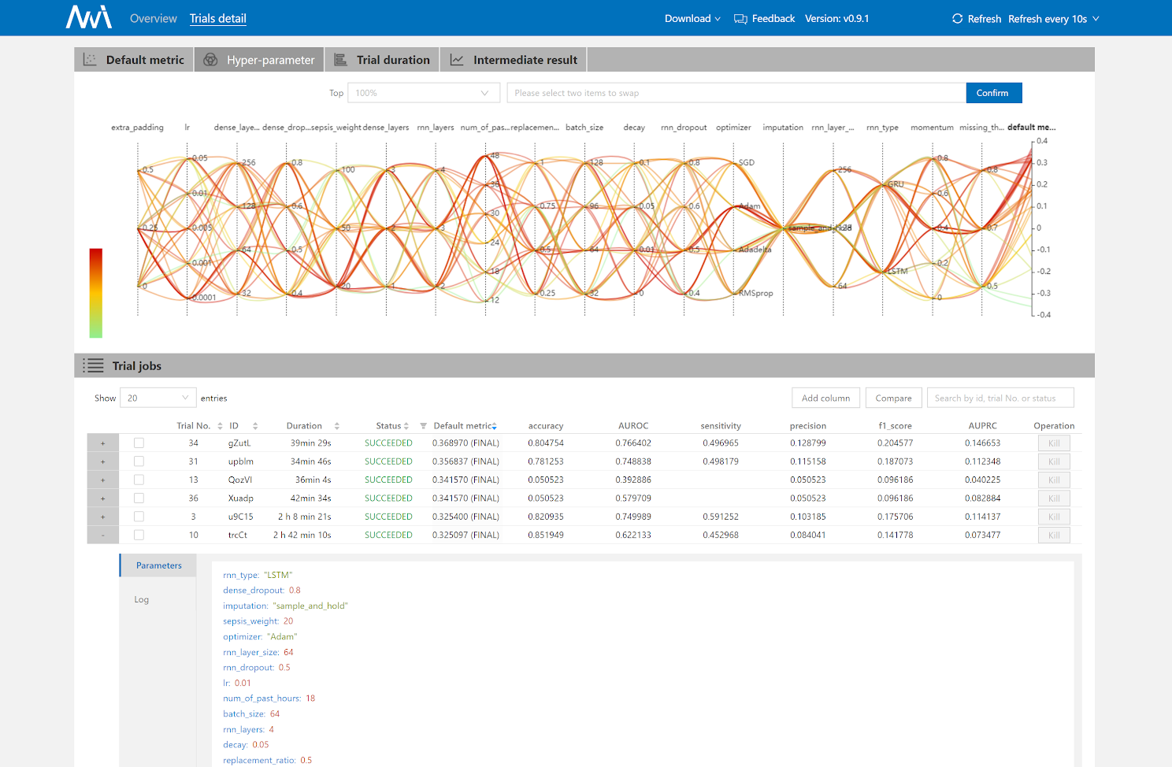
AutoML with Microsoft NNI

Slide 30
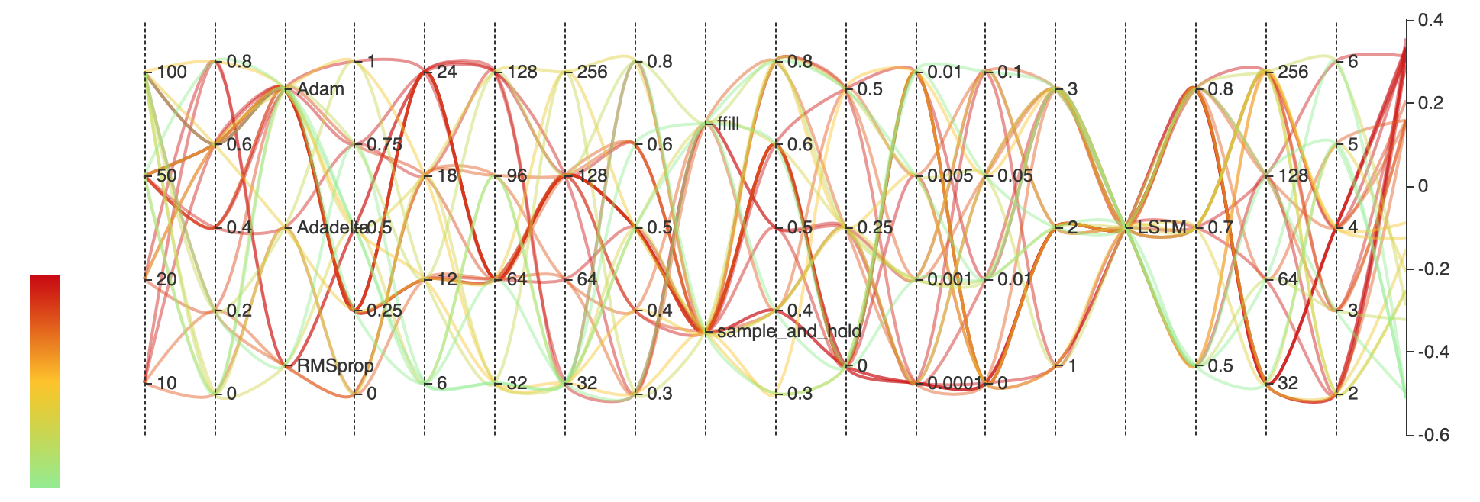
Hyperparameter Optimization
Experiment 1- All Models
Sepsis
Weight
Optimizer
Number of
Past Hours
Dense Layer
Size
Imputation Method
Extra
Padding
Learning Rate
Decay
RNN
Type
RNN Layer
Size
Momentum
Upsampling Ratio
Batch
Size
Dense Layer
Dropout
RNN
Dropout
Learning
Rate
Number of
Dense Layers
Missing Data
Threshold
Number of
RNN Layers
Notes:
search method= Tree-structured Parzen Estimator (TPE); sequentially construct models to approximate the performance of hyperparameters based on historical measurements

Slide 31
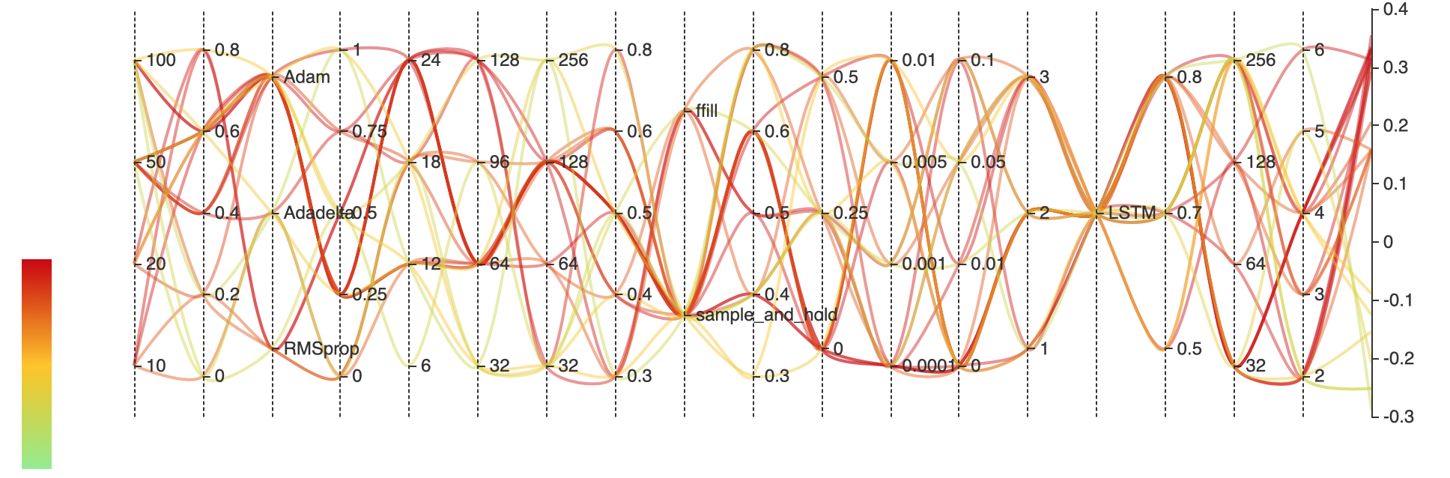
Hyperparameter Optimization
Experiment 1- Top 80% of Models
Sepsis
Weight
Optimizer
Number of
Past Hours
Dense Layer
Size
Imputation Method
Extra
Padding
Learning Rate
Decay
RNN
Type
RNN Layer
Size
Momentum
Upsampling Ratio
Batch
Size
Dense Layer
Dropout
RNN
Dropout
Learning
Rate
Number of
Dense Layers
Missing Data
Threshold
Number of
RNN Layers

Slide 32
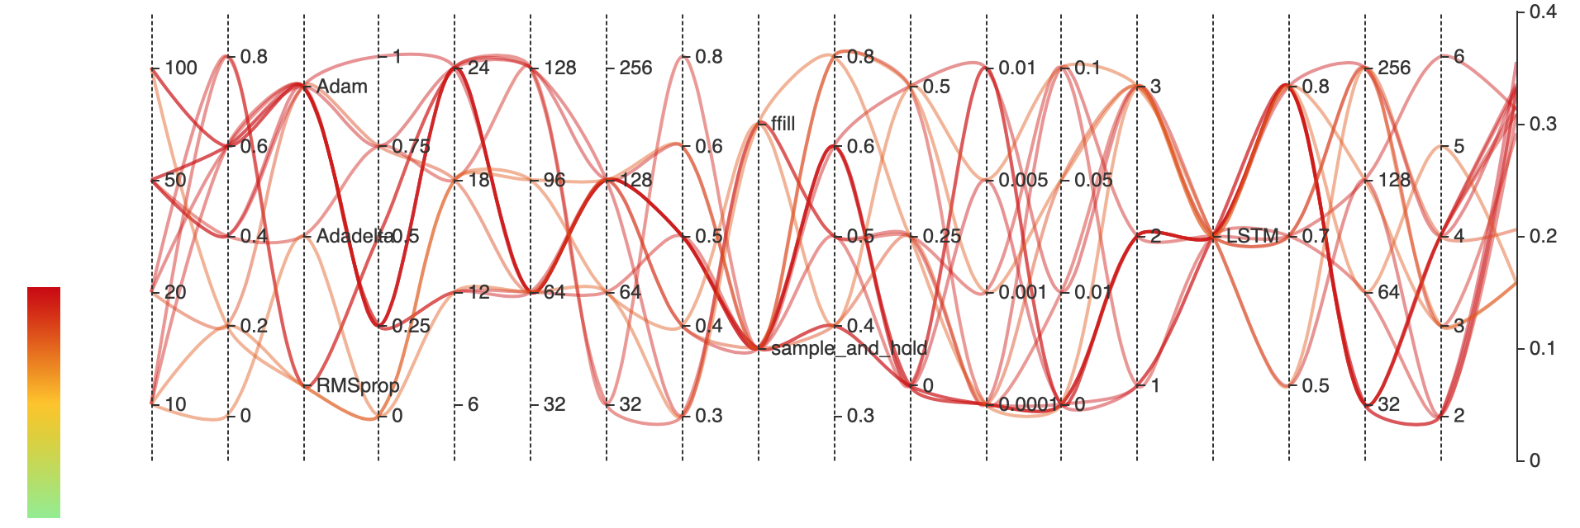
Hyperparameter Optimization
Experiment 1- Top 50% Models
Sepsis
Weight
Optimizer
Number of
Past Hours
Dense Layer
Size
Imputation Method
Extra
Padding
Learning Rate
Decay
RNN
Type
RNN Layer
Size
Momentum
Upsampling Ratio
Batch
Size
Dense Layer
Dropout
RNN
Dropout
Learning
Rate
Number of
Dense Layers
Missing Data
Threshold
Number of
RNN Layers

Slide 33
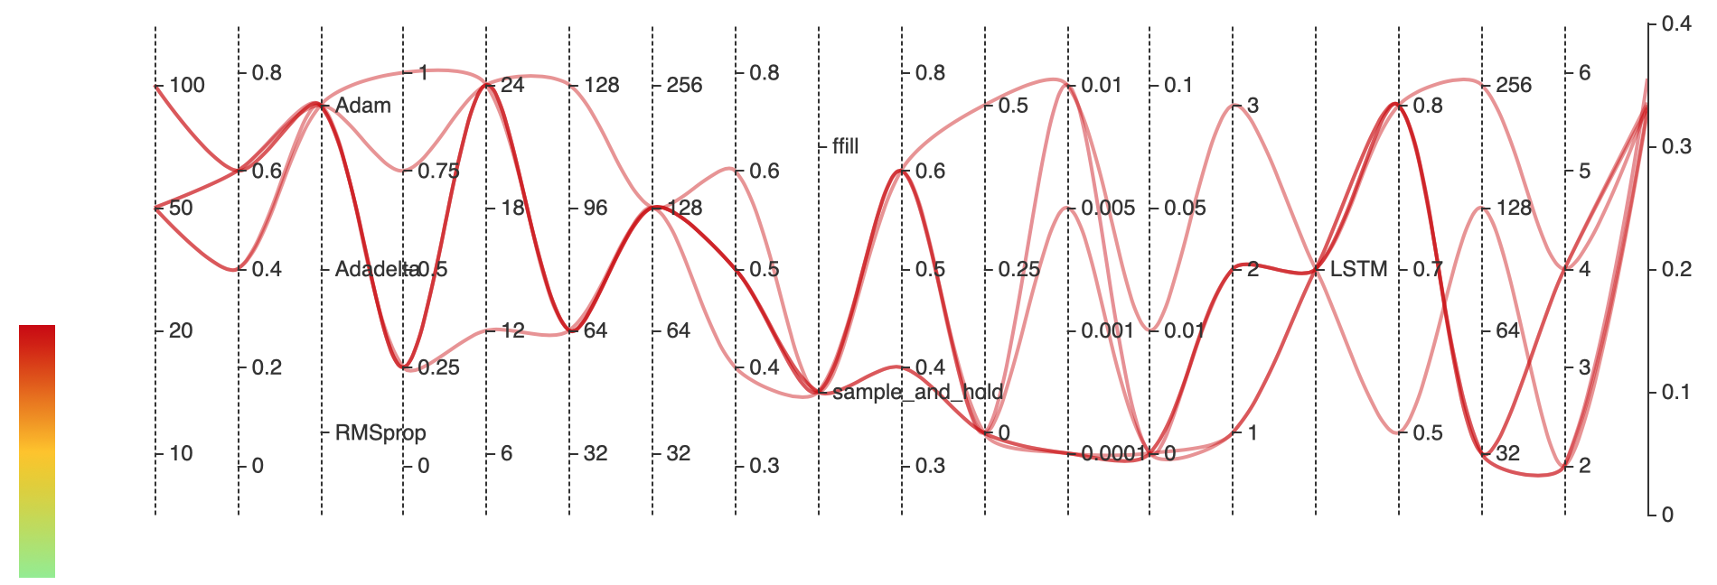
Hyperparameter Optimization
Experiment 1- Top 20% of Models
Sepsis
Weight
Optimizer
Number of
Past Hours
Dense Layer
Size
Imputation Method
Extra
Padding
Learning Rate
Decay
RNN
Type
RNN Layer
Size
Momentum
Upsampling
Ratio
Batch
Size
Dense Layer
Dropout
RNN
Dropout
Learning
Rate
Number of
Dense Layers
Missing Data
Threshold
Number of
RNN Layers
Notes:
Show progression of how certain hyperparameters seemed to work best
*Sample and hold
*RMS prop was never the best
*More hours previous was better

Slide 34
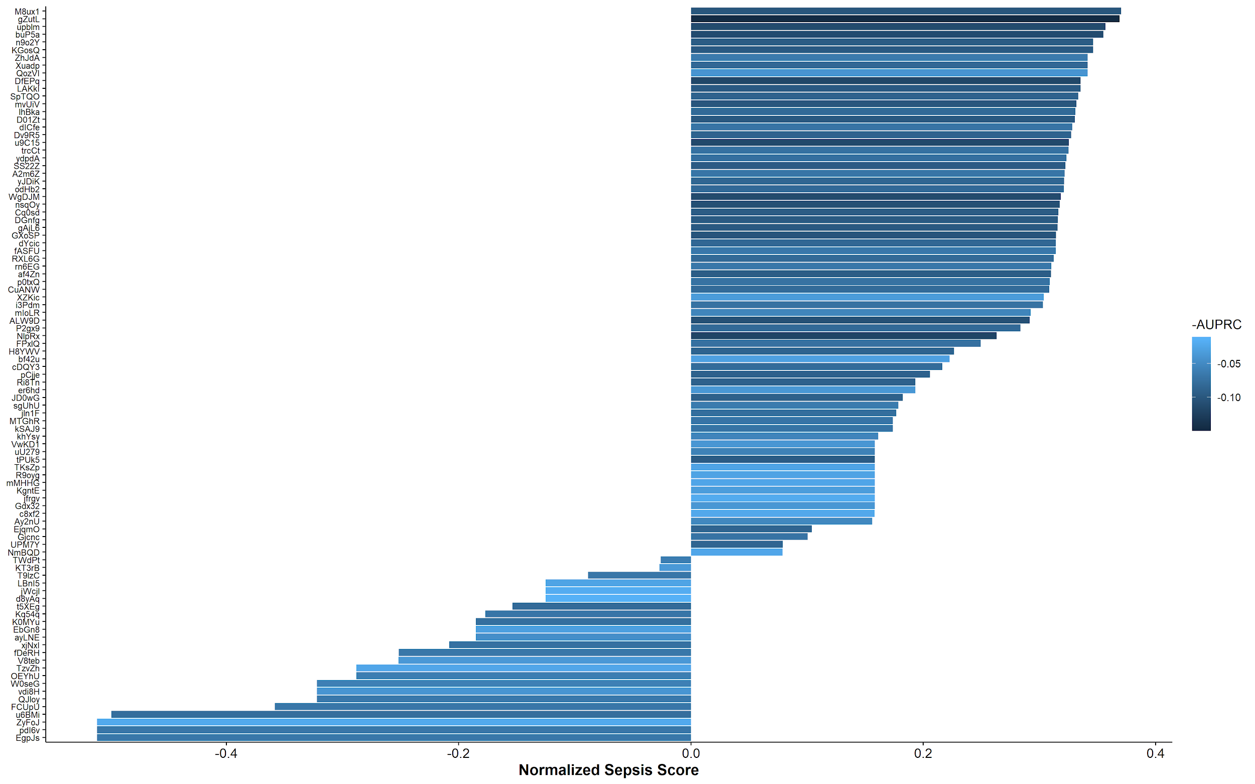
Results from 95 RNN Models

Slide 35
Parameters for our Model
Data Preprocessing
Imputation Method: Sample and Hold
Missing Threshold: 0.70
Number of Past Hours: 12
Upsampling Ratio: 0.25
Extra Padding: 0.25
Model Architecture
RNN Type: GRU
Number of RNN Layers: 3
RNN Layer Size: 64
RNN Dropout: 0.4
Number of Dense Layers: 2
Dense Layer Size: 64
Dense Dropout: 0.4
Gradient Descent
Sepsis Class Weight: 50
Optimizer: SGD
Batch Size: 96
Learning Rate: 0.001
Decay: 0
Momentum: 0

Slide 36
Results – Final Model Relative Performance
Rank | Utility Score
1 | 0.423
2 | 0.422
3 | 0.417
...
57 | 0.371
58 | 0.370
...
256 | -0.329
Notes:
*Results compared to leaderboard (based on utility score); based on val data until we have test data
*25 percentile of the challenge, so not bad, but...

Slide 37
Results – Final Model Performance
 | Predicted Sepsis: No | Predicted Sepsis: Yes
Actual Sepsis: No | 188471 | 22686
Actual Sepsis: Yes | 2035 | 2413
Normalized Utility Score: 0.370
Accuracy: 0.885
Sensitivity: 0.542
Precision: 0.0961
F1 Score: 0.163
AUROC: 0.823
AUPRC: 0.101
Notes:
*Explain confusion matrix and explain why these measurements are not accurate for task at hand
doesn’t look good
Also, these measurements don’t quite fit the task at hand given that a false positive doesn’t account for predicting sepsis early (this is rewarded with the challenge)
Accuracy doesn’t consider the weighting (if you miss someone with sepsis and they die, this is much worse)

Slide 38
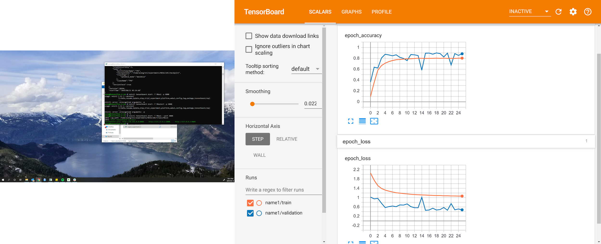
Model Performance: Tensorboard
Training Accuracy
Validation Accuracy
Training Loss
Validation Loss
Notes:
*Just not the right loss function for our purposes

Slide 39
Key Takeaways
Importance of imputation method for time-series data - Especially when features have different temporal resolutions
Methods to automate parameter searching for Neural Networks
Default loss function and metrics are insufficient for our clinical problem

Slide 40
Limitations
Confusion matrix is not a fair representation of the model performance
Model predicting sepsis early would be considered a false positive in the CM
Model is optimizing based on accuracy, which is not the main parameter we are trying to optimize
Loss can decrease, but this may be due to the model predicting “no” for all sepsis cases
Of >20 billion possible models, we tested 95
Would take ~5 million years to run on GCP

Slide 41
Future Directions
Evaluate more potential models
Evaluate model with test data
Evaluate each model at specific time steps for each individual
Include custom loss function as a hyperparameter

Slide 42
Thank you!
Questions?

